Slide 1

WS 203
Office 365 Feature Explosion:
What should you be using?

Slide 2








Paul Papanek Stork
Owner/Principal Architect
Don’t Pa..Panic Consulting
Author
Developer’s Guide to WSS 3.0
MOSS 2007 Best Practices
MCTS: WSS 3.0 Configuration Study Guide (70-631)
SharePoint 2010 Development for Office 365
Microsoft Community Contributor
    Technet Forums
    MSDN Forums
    Yammer Groups
Contact Information
Email:
pstork@att.net
Blog:
http://dontPaPanic.com/blog
Twitter:
@PStork
Notes:
Principal SharePoint Architect for BlueChip Consulting Group
http://www.bluechip-llc.com
SharePoint MVP for 9 years
SharePoint Microsoft Certified Master
Author
Developer’s Guide to WSS 3.0
MOSS 2007 Best Practices
MCTS: WSS 3.0 Configuration Study Guide (70-631)
SharePoint 2010 Development for Office 365
Contact Information
Email: Paul.Stork@bluechip-llc.com
Blog: http://dontPaPanic.com/blog
Twitter: @PStork

Slide 3
Agenda
The Problem and Promise caused by Frequent Updates
Workshop Approach
Application Categories
  Collaboration – Teams, Yammer, and Groups
  Forms/Workflow – Forms and PowerApps/Flow
  Video – Video and Stream
  Tasks – Tasks, Planner, and ToDo
  Presentations – PowerPoint and Sway
  Miscellaneous – StaffHub

Slide 4
Office 365 Frequent Updates
Advantages
  New functionality introduced more quickly
  Problem fixes roll out more quickly
Disadvantages
  Hard to keep track of what is being released
  Administrative controls aren’t always available upon release
  Applications sometimes seem to overlap
    Expanded Applications being introduced
    Obsolete Applications being deprecated
    Differing Visions from multiple Product Teams

Slide 5
Examples
InfoPath – Electronic Forms are Deprecated
  Original Proposal was to replace it with 4 different applications
  Currently PowerApps/Flow are the replacement
  Questions
    What about the “Forms” application developed for education market?
    Does the introduction of Flow mean Workflows are being replaced?
    What if PowerApps/Flow doesn’t do everything InfoPath did?
    Can I roll this out gradually to allow for training?
What is Microsoft’s View? – as expressed at Ignite 2017

Slide 6
Microsoft 365: Universal Toolkit for Teamwork
Outlook
SharePoint
Yammer
Office Apps
Teams
Email & Calendar
Intranets &
Content Management
Connect Across
the Organization
Co-Author
Hub for Teamwork
Office 365 Groups
Single team membership across apps and services
Microsoft Graph
Suite-wide intelligence connecting people and content
Security and Compliance
Centralized policy management

Slide 7
Microsoft 365 Teamwork Use Case Guidance
Yammer
Word, Excel, PowerPoint
Teams
Outlook
SharePoint
Email
& Calendar
Intranets
& Content Management
Connect Across
the Organization
Co-Author
A Hub for
Teamwork
EXAMPLE USE CASES
Upgrade your DL to a group inbox with shared notes and files
Share updates with your group in email
Keep your group in sync with a shared calendar
  Create a company intranet to share news and resources
  Customize your team site to automate document workflows and share lists
Share and work together on all your files with OneDrive
  Create a community around topics of interest or areas of practice
  Drive initiatives for cross-organizational innovation
Foster two-way engagement between leadership and staff
See whose in the file with you
Work together with real time co-authoring
Track what’s changed with version history
Iterate on a project with your team
Chat privately, and make audio, video calls
Set-up meetings with HD audio, video and web conferencing
Office 365 Groups Microsoft Graph Security and Compliance

Slide 8
Our Approach to this Workshop
Separate out the common applications like SharePoint, OneDrive, Outlook and Word
Divide remaining Applications into 5 categories
Compare/Contrast the Application in each category
  Brief Demonstration of the User Experience
  Discuss the Business Use Case for each Application
  Highlight Administrative Settings and Controls Available

Slide 9
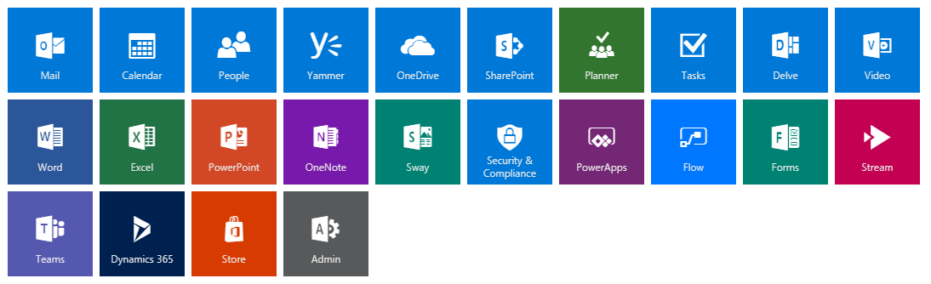


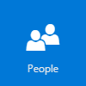











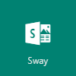








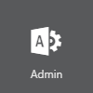
Office 365 Applications

Slide 10
Outlook Web Access

Slide 11
Office Web Applications

Slide 12
SharePoint, OneDrive, & Yammer

Slide 13
Administrative and Utility

Slide 14

Collaboration
Groups

Slide 15
Collaboration
Groups
Forms and Workflow

Slide 16
Collaboration
Groups
Forms and Workflow
Video

Slide 17
Collaboration
Groups
Forms and Workflow
Video
Tasklists

Slide 18
Collaboration
Groups
Forms and Workflow
Video
Tasklists
Presentations

Slide 19
Collaboration
Teams, Yammer, and Groups
Groups

Slide 20
Teams, Yammer, and Groups
Groups

Slide 21
Microsoft’s Current Guidance
Yammer
Teams
Outlook
Email
Inner Loop
Outer Loop
People you work with regularly on core projects
Files
Sites
Content
SharePoint
People you connect with openly across the organization
Ubiquitous for targeted communications
Office 365 Groups
Cross application group membership

Slide 22
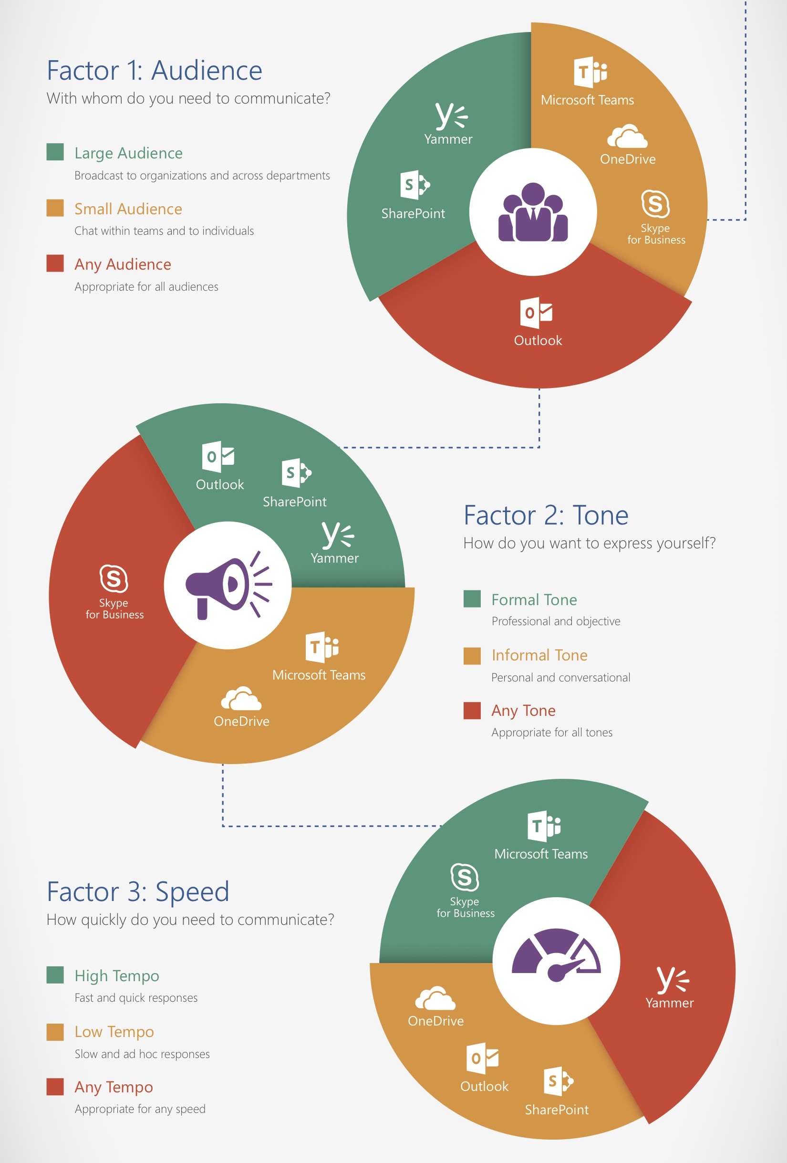
From AvePoint
Three Key Factors
  Audience
  Tone
  Speed

Slide 23
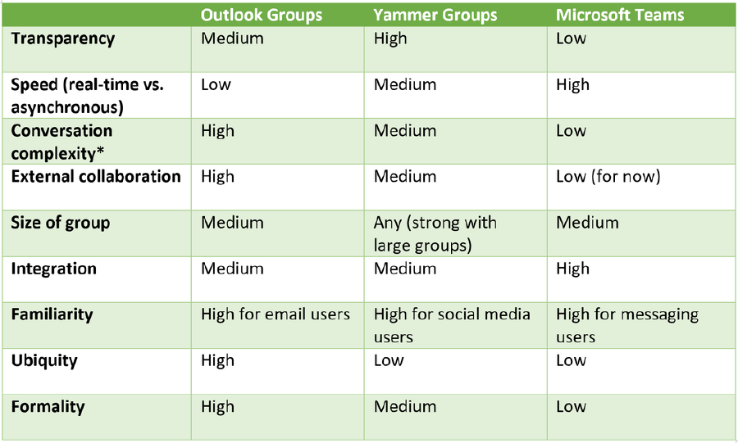
Another Business Case
See: https://medium.com/@cslemp/how-to-choose-between-microsoft-teams-yammer-and-outlook-1c4b37ac4eb7

Slide 24
Key Differentiators
Groups
  The Underlying functionality used by Yammer & Teams
  Driven by membership in a Security Group
  Surfaced in Outlook Web Access (OWA) and Outlook desktop client
Yammer
  Been around the longest – many experienced users
  Conversations can be referenced via a URL – better history
  Larger membership limits – Groups and Teams catching up
Teams
  Real time conversations – Soon to include Skype
  Bots for automation – Sideloaded Apps must be enabled in Settings
  Easily extensible – Tabs and custom development
  Best activity feed aggregation
Groups

Slide 25
When to Use Office Groups
To collect files, calendaring and some correspondence amongst a defined list of individuals (Security Group)
Users rely heavily on Outlook for day to day work

Slide 26
When to Use Yammer
To learn and share knowledge around an idea or topic
Can be configured to use Office Groups as Backend storage
  Limitation - One Yammer Network per Office Tenant
  Limitation - Office 365 Authentication must be enforced
Membership unlimited internal and external if not using an O365 Group
You have a lot of experienced Yammer users

Slide 27
When to Use Microsoft Teams
To execute shared tasks or a project
You want to customize the automated functionality (Bots)
You want to Organize Content (Tabs)
Membership limited to 2,500 users (originally 600)

Slide 28
Administrative Controls
Groups - On by default
  Enable External members under Settings>Services & add-ins>Office 365 Groups
  Limit Group Creation in Azure PowerShell
Teams - On by default
  Disable for Internal or External users under Settings>Services & add-ins>Microsoft Teams
  Remove User Licenses (won’t disable users with existing accounts)
  Other settings under Settings>Services & add-ins>Microsoft Teams
  Limit Team Creation - See Groups above
  New Admin Center combined with Skype (rolling out now)
Yammer – On by default in New Tenants
  Disable for whole Tenant in SharePoint Admin Center
  Remove User Licenses (won’t disable users with existing accounts)
  Enforce O365 Authentication to control User access
Groups
Notes:
https://support.office.com/en-us/article/Learn-about-Office-365-groups-b565caa1-5c40-40ef-9915-60fdb2d97fa2
New Teams Admin Center coming soon - https://docs.microsoft.com/en-us/MicrosoftTeams/enable-features-office-365

Slide 29
Limit Who Can Create Groups
Requires AzureADPreview Cmdlets Minimum Version 2.0.0.137
  Install-Module AzureADPreview
  Connect-AzureAD
  $Template = Get-AzureADDirectorySettingTemplate |
  where {$_.DisplayName -eq 'Group.Unified'}
  $Setting = $Template.CreateDirectorySetting()
  New-AzureADDirectorySetting -DirectorySetting $Setting
  -ErrorAction SilentlyContinue
  $Setting = Get-AzureADDirectorySetting -Id (Get-AzureADDirectorySetting |
  where -Property DisplayName -Value "Group.Unified" -EQ).id
  $Setting["EnableGroupCreation"] = $False
  $Setting["GroupCreationAllowedGroupId"] = (Get-AzureADGroup
  -SearchString "AllowedtoCreateGroups").objectid
  Set-AzureADDirectorySetting -Id (Get-AzureADDirectorySetting | where –Property
  DisplayName -Value "Group.Unified" -EQ).id -DirectorySetting $Setting
  (Get-AzureADDirectorySetting).Values
Notes:
https://support.office.com/en-us/article/Manage-who-can-create-Office-365-Groups-4c46c8cb-17d0-44b5-9776-005fced8e618

Slide 30
Limit Who Can Create Groups - Results
Name Value
---- -----
CustomBlockedWordsList
EnableMSStandardBlockedWords false
ClassificationDescriptions
DefaultClassification
PrefixSuffixNamingRequirement
AllowGuestsToBeGroupOwner false
AllowGuestsToAccessGroups False
GuestUsageGuidelinesUrl
GroupCreationAllowedGroupId Daf77338-4716-4be7-b612-7972c06ea968
AllowToAddGuests True
UsageGuidelinesUrl
ClassificationList
EnableGroupCreation False

Slide 31
Disable Yammer or Team User License
$disableplanList=@("YAMMER_ENTERPRISE", "TEAMS1",
"<Other Disabled Licenses>")
$cred = Get-Credential -UserName "<Your Global Admin Account>"
-Message "Enter O365 Global Admin Credentials"
Connect-MsolService -Credential $cred
$AccountSku = Get-MsolAccountSku |
Where-Object {$_.SkuPartNumber -eq 'ENTERPRISEPACK'}
$NewSkU = New-MsolLicenseOptions
-AccountSkuId $AccountSku.AccountSkuid
-DisabledPlans $disableplanList
Set-MsolUserLicense -UserPrincipalName "<User Account to disable>"
-LicenseOptions $NewSkU
(Get-MsolUser –UserPrincipalName "<User Account to disable>")
.Licenses.ServiceStatus

Slide 32
Forms/Workflow
Forms, PowerApps, and Flow

Slide 33
What about InfoPath & Workflow
InfoPath 2013 is deprecated
  No longer being developed – Not keeping pace with new features like Modern Libraries
Workflow 2010 and 2013
  Still fully supported
  Hard to integrate with external data sources

Slide 34
Forms, PowerApps and Flow

Slide 35
Administrative Controls
Forms - On by default
  Enable External sharing under
  Settings>Services & add-ins>Microsoft Forms
  Remove User Licenses (won’t disable users with existing accounts)
PowerApps - On by default
  Manage through PowerApps Admin center
  Remove User License (Users can still sign up for free service)
Flow - On by default
  Manage through Flow Admin center
  Remove User License (Users can still sign up for free service)

Slide 36
Disable Forms, PowerApps & Flow License
$disableplanList=@("FORMS_PLAN_E3", "POWERAPPS_O365_P2",
"FLOW_O365_P2", "<Other Disabled Licenses>")
$cred = Get-Credential -UserName "<Your Global Admin Account>"
-Message "Enter O365 Global Admin Credentials"
Connect-MsolService -Credential $cred
$AccountSku = Get-MsolAccountSku |
Where-Object {$_.SkuPartNumber -eq 'ENTERPRISEPACK'}
$NewSkU = New-MsolLicenseOptions
-AccountSkuId $AccountSku.AccountSkuid
-DisabledPlans $disableplanList
Set-MsolUserLicense -UserPrincipalName "<User Account to disable>“
-LicenseOptions $NewSkU
(Get-MsolUser –UserPrincipalName "<User Account to disable>")
.Licenses.ServiceStatus

Slide 37
When to Use Forms
For creating simple surveys & quizzes
  Automated Statistics and summarization
  Up to 5,000 responses (Internal & External)
  Data is stored on servers in the United States and Europe
Form is a list of questions
Quiz is a form with additional options
  Assign Points for a questions
  Supports Math notation for questions/answers
Not a Replacement for InfoPath

Slide 38
When to Use PowerApps
To provide a CRUD interface for managing information in SharePoint or other data repositories
As an Input form for a FLOW
Designed as replacement for InfoPath
  Accessible directly from Modern List menu
  New, View, and Edit PowerApps forms display inline
  Mobile client available
  Not suitable for duplicating Paper Forms “look and feel”
Some workloads require additional licensing
  Common Data Model
  Salesforce

Slide 39
When to Use Flow
Execute Processes and Tasks
Interact with data in external systems
Typical Tasks
  Approval
  Synchronize files
  Data Collection
  Autmated Processes
Lots of sample Templates to build on
Over 200 connectors available
Not a direct replacement for SharePoint workflow

Slide 40
Breaktime?
15:00 Minutes

Slide 41
Streaming Video
Video and Stream

Slide 42
Video and Stream

Slide 43
Administrative Controls
Video - On by default
  Disable in the SharePoint Admin Center under
  Settings>Streaming Video Service
  Manage User Permissions in
    Video Portal Settings
    Individual Channel Settings
Stream - On by default
  Block Login to Microsoft Stream in Azure AD Applications
  Remove User License (Users can still sign up for free service)

Slide 44
Block Application Login in Azure AD
Open Azure AD Admin Center
Select Enterprise applications
Find “Microsoft Stream Service”
Select the application
Click Properties under Manage from the left blade.
Toggle the Enabled for users to sign-in flag to No.
Click the Save button at the top of the screen.
"

Slide 45
Differences
Stream
  Add as a Tab in Teams
  Broader Licensing - based on Azure AD – O365 license not required
  Search Integration - offers automated transcription
  Table of Contents – Jump to a point in the video
  Limitations
    No External User Access
    Authentication issues with Mobile Applications
Office 365 Video
  APIs not yet available in Stream

Slide 46
Should I Switch to Stream Now
Continue using Video if you have developed customizations
Microsoft Stream will eventually replace Video Portal
  Phase 1 (2017 Q3/Q4) – Tenant Admin Opt-in for Clients not using REST APIs
  Phase 2 – Tenant Admin Opt-out - Tenant Admins can Opt-out
  Phase 3 – Automatic Transition – tenants transitioned to Stream
    Content will be automatically migrated from Video to Stream
Use Stream if you use Microsoft Teams
Notes:
Stream Migration Info - https://docs.microsoft.com/en-us/stream/migrate-from-office-365

Slide 47

Tasks
Tasks, Planner and ToDo

Slide 48
Tasks, Planner, and ToDo

Slide 49
Administrative Controls
Tasks – On by default
  Disable Exchange Mailbox
Planner - On by default
  Manage User Permissions in underlying O365 Group Site
  Limit Group Creation in Azure PowerShell
ToDo – Still in Preview
  Enable Preview application under Settings>Services & add-ins>ToDo
  Remove User License (Existing Users will be able to use ToDo)
  Disable Exchange Mailbox

Slide 50
Disable ToDo & Planner License
$disableplanList=@("BPOS_S_TODO_2", " PROJECTWORKMANAGEMENT",
"<Other Disabled Licenses>")
$cred = Get-Credential -UserName "<Your Global Admin Account>"
-Message "Enter O365 Global Admin Credentials"
Connect-MsolService -Credential $cred
$AccountSku = Get-MsolAccountSku |
Where-Object {$_.SkuPartNumber -eq 'ENTERPRISEPACK'}
$NewSkU = New-MsolLicenseOptions
-AccountSkuId $AccountSku.AccountSkuid
-DisabledPlans $disableplanList
Set-MsolUserLicense -UserPrincipalName "<User Account to disable>"
-LicenseOptions $NewSkU
(Get-MsolUser –UserPrincipalName "<User Account to disable>").Licenses.ServiceStatus

Slide 51
Business Case
Planner
  Best for a Team
  Mobile App Available
  KanBan card view
ToDo
  Focus on things tasks for Today
  Mobile App Available
Tasks
  Integrated with Outlook desktop and OWA

Slide 52
Presentations
PowerPoint and Sway

Slide 53
PowerPoint and Sway

Slide 54
Administrative Controls
PowerPoint - On by default
  Disable Office 365 ProPlus licensing
Sway – On by default
  Enable External Sharing and Data Sources under
  Settings>Services & add-ins>Sway
  Remove User License (Users can still sign up for free service)

Slide 55
Disable Sway License
$disableplanList=@(“SWAY", "<Other Disabled Licenses>")
$cred = Get-Credential -UserName "<Your Global Admin Account>"
-Message "Enter O365 Global Admin Credentials"
Connect-MsolService -Credential $cred
$AccountSku = Get-MsolAccountSku |
Where-Object {$_.SkuPartNumber -eq 'ENTERPRISEPACK'}
$NewSkU = New-MsolLicenseOptions
-AccountSkuId $AccountSku.AccountSkuid
-DisabledPlans $disableplanList
Set-MsolUserLicense -UserPrincipalName "<User Account to disable>"
-LicenseOptions $NewSkU
(Get-MsolUser –UserPrincipalName "<User Account to disable>")
.Licenses.ServiceStatus

Slide 56
Business Case
PowerPoint
  Primarily a Desktop application
  Best for a live presentation
  More fine grained control over final presentation
Sway
  A Web based application
  Best for online and on-demand presentation
  Better for rich media presentations that rely more on images, video, and style

Slide 57

Miscellaneous
StaffHub

Slide 59
Other Talks at SharePoint Fest
WF101 - Workflows and Forms in Microsoft world - when to use what? - Asif Rehmani
OFF 202 - Office 365 Groups - The Ultimate Guide - Benjamin Niaulin
BV101 - Increasing Project Efficiency using Microsoft Teams - Haniel Croitoru
WF102 - Introduction to Microsoft Flow- Daniel Glenn
PWR102 - PowerApps for SharePoint Users – Wes Preston
PWR103 - Power Up SharePoint with PowerApps - Bobby Chang
WF104 - Approvals in Flow - Scott Shearer
ADM106 - Microsoft Teams for Administrators - Matthew J. Bailey
PWR201 - Introduction to Office 365 Groups - Drew Madelung
PWR303 - Learn what's new and coming with Office 365 Business Apps (SharePoint, PowerApps, Flow, Forms) - Chris McNulty

Slide 60
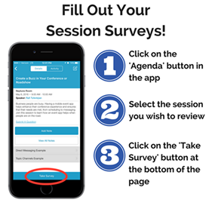
Questions?
Contact Information
  Email: Paul.Stork@dontpapanic.com
  Blog: http://dontPaPanic.com/blog
  Twitter: @PStork

